Slide 1
Change Colors and
make your way
to the Top

Slide 2
Float on Clouds
And Collect Fruit

Slide 3
But Beware,
Powerful Bosses Await

Slide 4


Slide 5

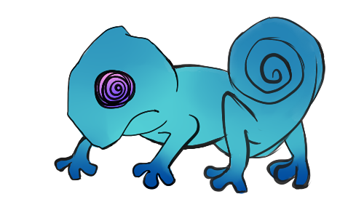



Slide 6

Masahiro Ward Vaidehi Narayan Pauline Do

Slide 7
Masahiro Ward Vaidehi Narayan Pauline Do

Slide 8
Masahiro Ward Vaidehi Narayan Pauline Do

Slide 9
But Beware,
Powerful Bosses Await

Slide 10
Team MVP:
Masahiro Ward
Vaidehi Narayan
Pauline Do

